Slide 1
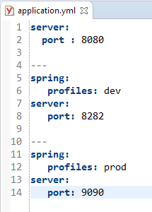
How to Use Profiles in Spring Boot? (application.yml)
We can keep the Spring active profile properties in the single application.yml file. No need to use the separate file like application.properties.
The following is an example yml file, to keep the Spring active profiles in application.yml file. Note that the delimiter (---) is used to separate each profile in application.yml file.
Development Environment
Production
Environment

Slide 2
How to Use Profiles in Spring Boot? (application.yml)
While running the JAR file, we need to specify the spring active profile based on each properties file. By default, Spring Boot application uses the application.properties file.
You can see active profile name on the console log
java -jar HelloWorld-0.0.1-SNAPSHOT.jar --spring.profiles.active=prod
java -jar HelloWorld-0.0.1-SNAPSHOT.jar --spring.profiles.active=dev
java -jar HelloWorld-0.0.1-SNAPSHOT.jar
mvn clean install

